Slide 1
Computational modelling of a bouncing ball using differential equations of motion

Slide 2
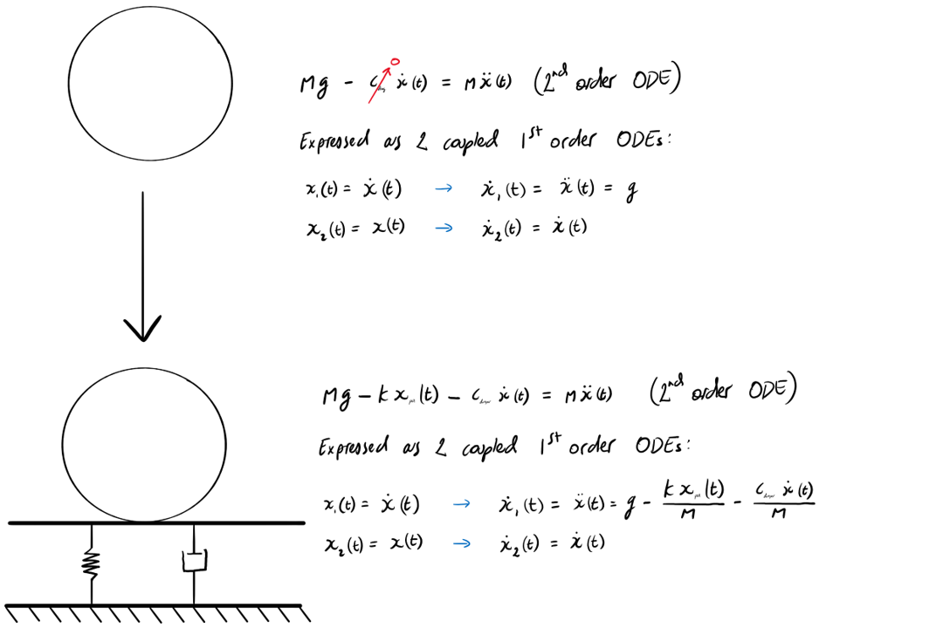
Phase 1
Phase 2

Slide 3
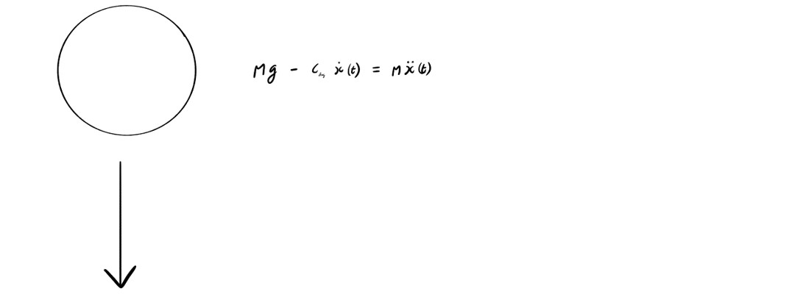
Phase 1
Phase 2

Slide 4
Phase 1
Phase 2

Slide 5
Phase 1
0
Phase 2

Slide 6
Phase 1
0
Phase 2

Slide 7
Phase 1
0
Phase 2

Slide 8
Phase 1
Pseudocode: ball.m
xdot = ball(t,x)
compute ground penetration
if there is not penetration
apply EOM for phase 1
else apply EOM for phase 2
Phase 2

Slide 9
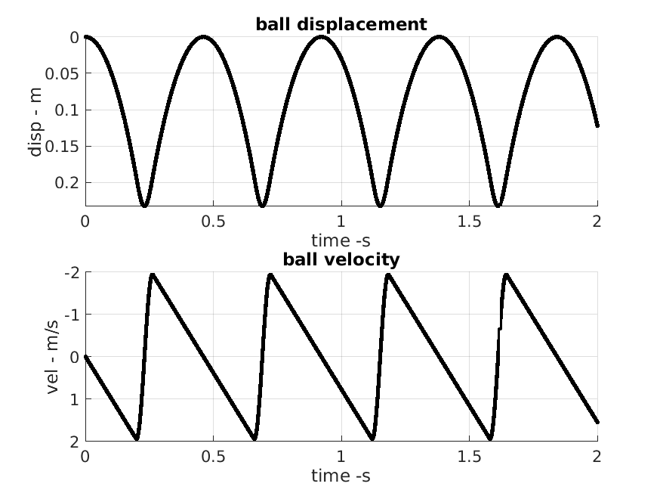
g = 9.81;k = 500; m = 0.2; h=0.2; r = 0.01;

Slide 10
Phase 1
Phase 2

Slide 11
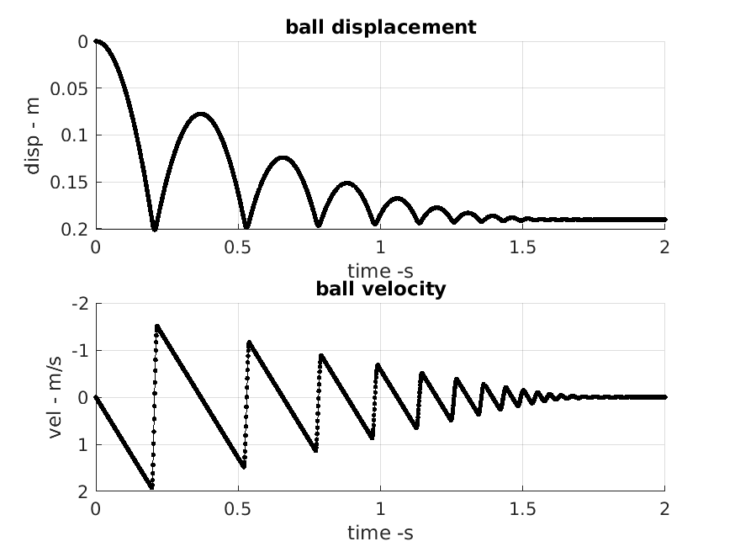
g = 9.81;k = 5,000; c=5; m = 0.2; h=0.2; r = 0.01;

Slide 12
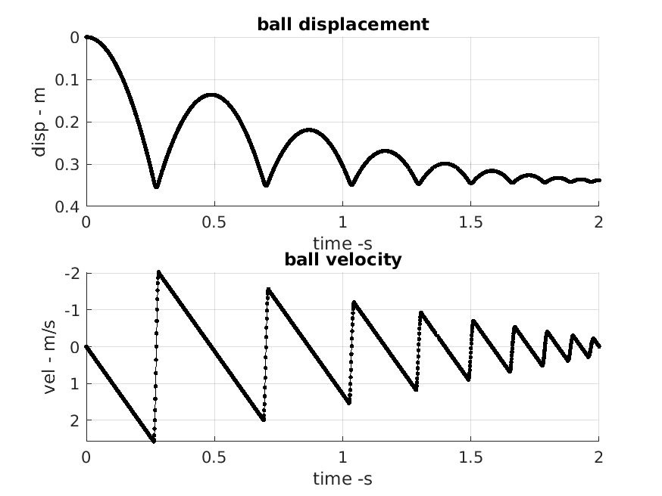
g = 9.81;k = 5,000; c=5; m = 0.2; h=0.35; r = 0.01;

Slide 13
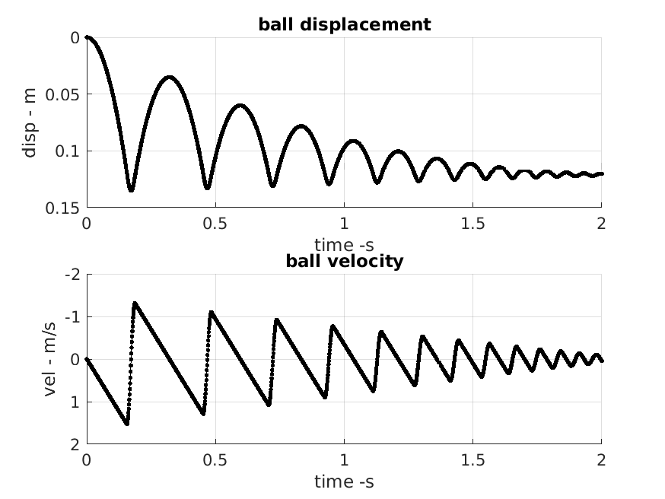
g = 9.81;k = 5,000; c=5; m = 0.5; h=0.35; r = 0.08;

Slide 14
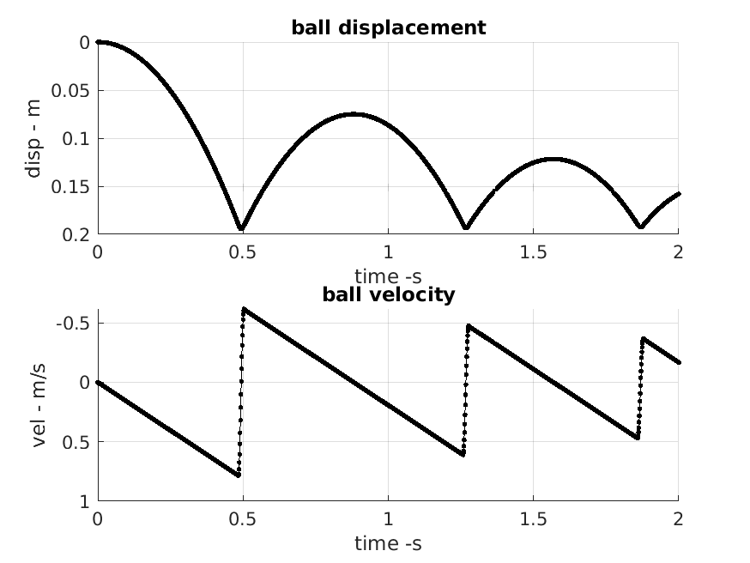
g = 1.62;k = 5,000; c=5; m = 0.2; h=0.2; r = 0.01;

